Slide 1
6. The BIM Execution Plan (BEP). Producing documents
Practical task

Slide 2
Excerpt from the actual purchase specification of the customer's construction services:
“The building information modelling must make it possible to increase the efficiency of design work, to manage project data in such a way that relevant information, such as element quantities, their parameters, etc. is easily accessible at all times and to help find optimal design solutions, simulate different scenarios and perform analyzes of energy efficiency, lighting, thermal comfort and more. It would also improve the coordination of the project – different parts of the project (architectural, structural, engineering) would interact with each other, and a collision check would be performed.”

Slide 3
TASK:
Mark a list of use cases that will be applied upon receipt of such customer requirements in the table below.

Slide 4
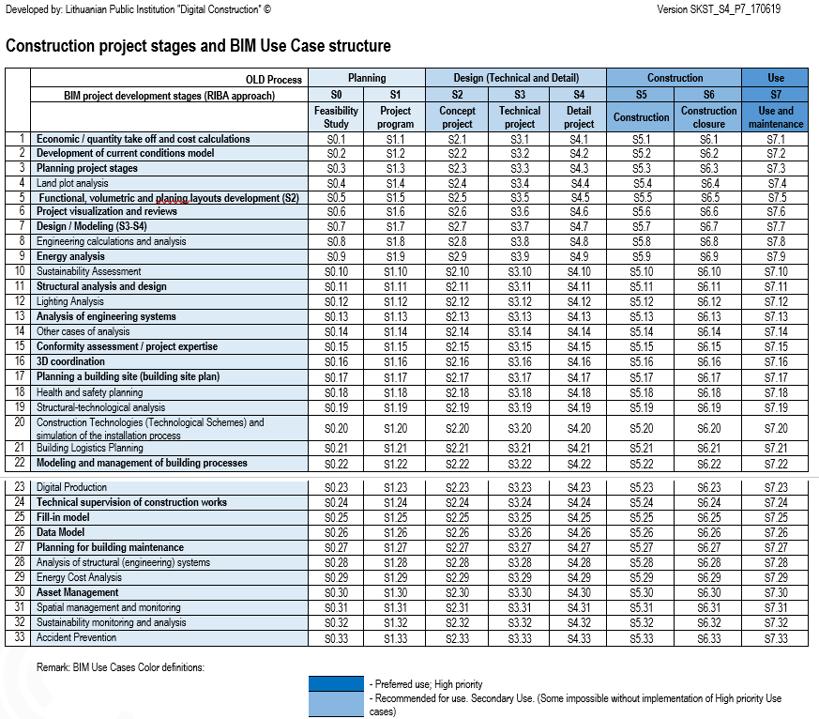

Slide 5
6. The BIM Execution Plan (BEP). Producing documents
Frequently Asked Questions

Slide 6
1. What does an Information requirement part of BIM execution plan contain?

Slide 7
The information requirements can state what, when, how produced, and for whom the information is needed. The information requirements are organizational, asset or project and exchange information requirements. It is recommended that the OIR, AIR or PIR, that the EIR is derived from, are also included but this is not mandatory. Information requirements should be a description of the purpose for organizational objectives, operation of an asset or delivery of an asset.
For example: At the start of operations, the end-user wants to know how to manage the new asset on a day by day basis.

Slide 8
2. What does an Level of Information Need part of BIM execution plan contain?

Slide 9
The level of information need is a framework which defines the extent and granularity of information. They shall be defined by different concepts: Geometrical information, alphanumerical information, and documentation. Stating the level of information need helps the appointed party to produce only what is needed and saves time from over or underproduction of information.
Level of information need describes the quality, quantity, and granularity of the information delivery exchange during each appointment. This is to be done by describing first the purpose of the required information, when the information is required, by whom and to which object within the breakdown structure it is associated.

Slide 10
3. What does an Acceptance Criteria part of BIM execution plan contain?

Slide 11
The acceptance criteria are the conditions used to check that the information is delivered in the correct way, not that the contents of the information are correct.
Acceptance criteria encompass the project’s information standard, the project’s information production methods and procedures and reference information or shared resources.
The acceptance criteria are used to ensure that deliverables are compliant with the information requirements.
The project’s information standard describes project-specific criteria to support the consistency and exchange of information required for the project. When establishing the project’s information standard, the following shall be considered: Requirements to level of information need, the use of open BIM standards, the means of structuring and classifying information, information formats needed for further use of information in later project phases and for asset operation etc.
Project's information production methods and procedures define the approaches and techniques the appointed party uses to create, manage and approve information.
Project's reference information and shared resources are existing information that shall be used or referred to by the appointed parties when producing the information deliverables. The appointing party shall make available all existing or predefined information as detailed by the appointment.

Slide 12
4. What does an Supporting Information part of BIM execution plan contain?

Slide 13
Supporting information is existing information that could be used or referred to by the appointed party when producing the information deliverables or preparing the tender response. The appointing party should make available all existing or predefined information as detailed by the appointment. Supporting information can help the lead appointed party to better understand or evaluate the information required or its acceptance criteria. This can be referenced to existing asset information or samples of exemplary information deliverables.

Slide 14
5. What does an Supporting Information part of BIM execution plan contain?

Slide 15
Project’s information delivery milestones specify when the information is needed by the appointing party. This should accommodate how much time is required to accept the information. This can be a date, frequency or relative to an event. Milestones allow the appointing party and the appointed parties to plan and resource the project. They should be respected by both parties to ensure the delivery schedule is achieved. Information exchanges can be required to accommodate internal coordination by the appointed party to quality ensure or other internal processes before the project milestones.

Slide 16
6. What are the benefits of BIM execution plan?

Slide 17
Stronger communication, alignment on standards and collaboration, save a lot of time.

Slide 18
Dr.Edita Šarkienė,
e.sarkiene@vtdko.lt
Vilnius College of Technologies and Design

Slide 19
This project has been funded with support from European Commission.
This publication [communication] reflects the views only of the author, and the Commission cannot be held responsible for any use which may be made of the information contained therein.

